Slide 1
Working but Still Poor: The Role of Regional Occupational Structure in Low Income Work
China Layne, Ph.D.
Summit Consulting, LLC
Suzanne Macartney, Ph.D.
Office of Assistant Secretary for Planning & Evaluation, Department of Health and Human Services
Prepared for Annual Conference of the Eastern Sociological Society, Baltimore, Maryland. February 22, 2014

Slide 2
Research Questions
How much does a person’s likelihood of being working poor or near poor vary across occupations?
Does a person’s likelihood of being working poor or near poor vary across regions?
Does a region’s occupational structure affect a person’s likelihood of being working poor or near poor?

Slide 3
Data
American Community Survey (ACS) 1-year 2011 Public Use Micro Sample (PUMS) file
The ACS is a nationally representative survey of 3 million household addresses each year,
Which collects housing, social, demographic, and economic information
Questions on work status refer to the last week before the interview.
Questions on income refer to the 12 month period preceding the interview date.
The 2011 survey period covers a year in the early recovery period after the end of the Great Recession. (National Bureau of Economic Research, 2013)
Regions: Public Use Micro Areas (PUMA) are contiguous geographies of at least 100,000 people that do not cross state boundaries.
Notes:
For ACS, the employment status question is asked in the most expansive way possible: “Did you do any work for pay, even for an hour?”
ACS collects information on only the main job held in the last week.
Income information is collected on eight different sources, including wages (including over time pay, bonuses, commissions and tips) on all jobs, self-employment / business income, social security, cash public assistance, and interest and dividends.
Income sources are asked about separately to help ensure accuracy of the information.
ACS also asks respondents to give their total money income in the last year from all sources.
For disclosure limitation reasons, ACS won’t identify any geography with fewer than 100,000 persons. Some counties and many metropolitan areas aren’t large enough to meet this threshold. So ACS provides only state and PUMAs as identifiable sub-national geographies.
Other surveys, such as the CPS, will identify counties and metropolitan areas as long as the individual geography meets the population threshold.

Slide 4
How Poverty is Measured
Poverty status is determined by comparing annual income to a set of
dollar values called poverty thresholds that vary by:
- family size
- number of children
- age of the householder (for 1 and 2 person households)
If a family’s before- tax money income is less than the dollar value of the threshold, then each person in family is considered to be poor.
The ACS uses thresholds updated annually to allow for changes in the cost of living from the Consumer Price Index (CPI-U). They do not vary geographically.
In this research, we consider workers who are poor (with income up to 100% of the poverty threshold) and those who are “near poor” (with income from 101% to 200% of the poverty threshold).
Notes:
Poverty thresholds: $11,702 for one person < 65 years, $15,063 for two adults both < 65 years, $18,123 for one adult and two children, $22,811 for two adults and two children.
Income sources included in the poverty measure are: wages, self-employment income, interest and dividends, cash public assistance, and income from programs such as social security and disability. Capital gains and “in-kind” benefits such as SNAP and housing and utility assistance are not included.
Income is reported for the previous 12 months. So the correct poverty threshold for each family is determined by multiplying the base year poverty threshold (1982) by the average monthly CPI values for the 12 months prior to the interview.

Slide 5
Regional occupational structure is measured by the percent of a region’s workforce employed in each of eight occupation groups.
Notes:
This study uses the 5 major occupation categories from the 2010 Census occupational classification, with a few changes:
Separated Education and Healthcare from Management because their median earnings are lower.
Separated Protective Services from Services because its median earnings are higher.
In 2010 Census occupation codes, first line supervisors are included with their respective occupations, but higher level managers are included in the management occupation group. For example: a fast food supervisor is coded as “first-line supervisors of food preparation and serving workers” but the restaurant manager is coded as “food service manager”.
I chose to use the 2011 single year file partly because of the complexity of occupation codes on the public use file.
In 2010, the Census occupation codes were updated to reflect the 2010 SOC.
For the public use file, every occupation code must have at least 1,000 weighted persons for every PUMA (disclosure limitation threshold). When PUMA boundaries change, for instance in 2012, occupation codes must be re-assessed and revised if any code fails to meet the disclosure limitation threshold.
This means that post-2009, multi-year, public use files will include at least two, possibly three, different sets of occupational codes.

Slide 6
Analysis Sample and Models
The analysis sample includes residents of all 2,069
PUMAs in the United States who are:
At least 16 years of age,
White, Black or African American, Asian, or Hispanic, and
Employed.
To model a person’s likelihood of being working poor or near poor, we use a two-level, logistic, random-intercept model.
1,351,228 people are nested within 2,069 PUMAs.
A person’s likelihood of being working poor or near poor varies randomly across PUMAs.
Models separately test the effects of individual and regional characteristics on the likelihood of being working poor or near poor.
Notes:
Individual characteristics include basic demographics, human capital characteristics, work experience, and measures of family resources and needs.
Regional characteristics include composition of workforce, employment policies, economic growth, and in-migration measure.

Slide 7
Many worker characteristics are strongly related to poverty status, including: age, education level, and fertility. Young adults account for fully 29% of workers with poverty level income, but less than 10% of non-poor workers.
Age

Slide 8
Individuals with only a high school diploma or GED represent 40% of workers with near poverty level income but 30% of non-poor workers.
Source: American Community Survey, 2011

Slide 9
About 40% of workers with near poverty and poverty level incomes have minor children in the household, compared with 31% of non-poor workers.
Source: American Community Survey, 2011

Slide 10
Regions vary substantially by demographic and economic characteristics, especially the percentage of working poor and near poor residents.
American Community Survey, 2011

Slide 11
Occupational structure varies substantially by region, especially for service occupations and management, business, science, and arts occupations.
Management, business, science, arts 19.5
American Community Survey, 2011

Slide 12
Denver has a larger share of its workforce in management, business, science, and arts occupations than the U.S. overall.
Management, business, science, arts 19.5
Sales, office, administration 24.6
American Community Survey, 2011

Slide 13
Greensboro, North Carolina has a larger share of its workforce in sales and office administration occupations than the U.S. overall.
American Community Survey, 2011

Slide 14
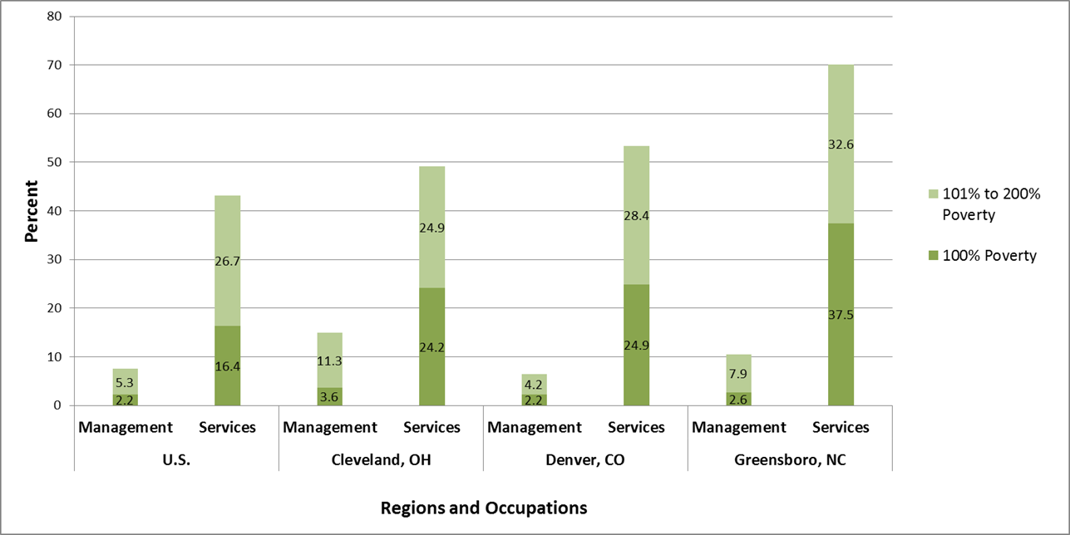
Poverty rates vary substantially across occupations, particularly service occupations, and management, business, science and arts occupations.
American Community Survey, 2011

Slide 15
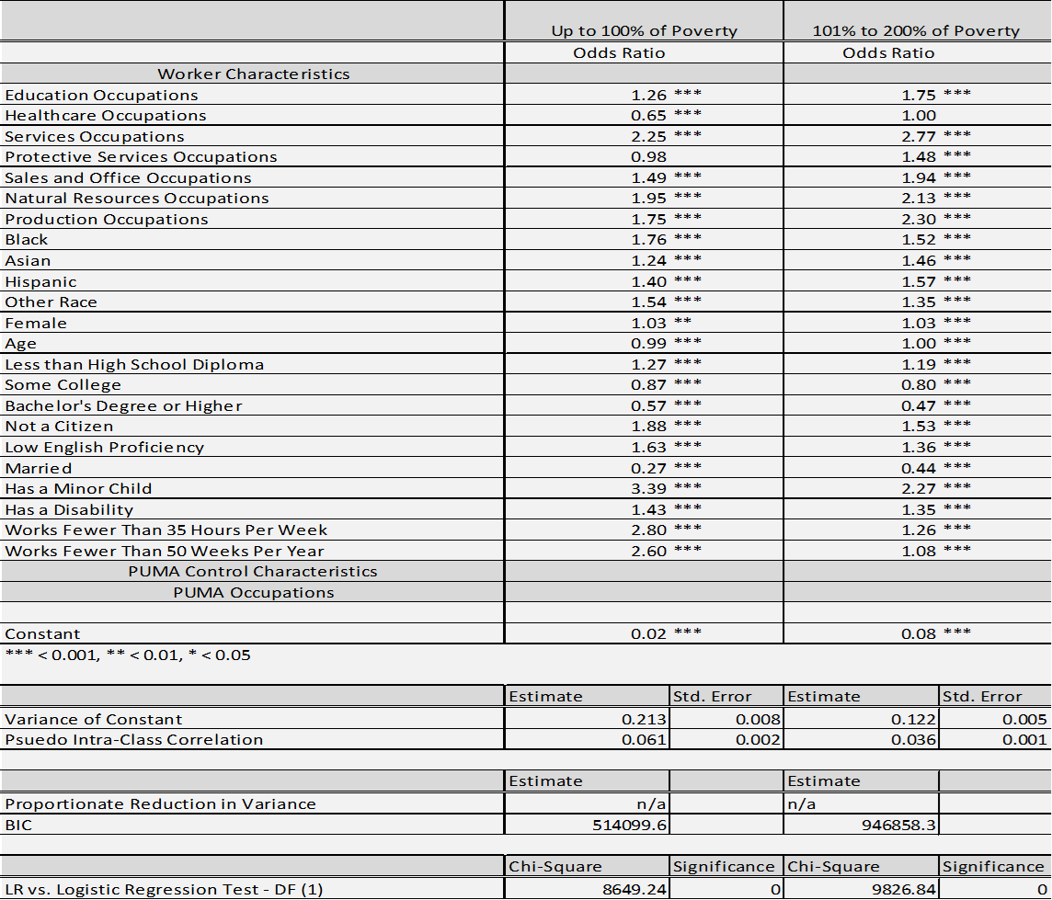
Model One Results – Worker Characteristics
Notes:
For 95% of PUMAs, the probability of a management worker being working poor falls between 1% and 5%.
For 95% of PUMAs, the probability of a management worker having a near poor income falls between 3% and 12%.
- The LR test suggests that the multilevel logistic model is an improvement over the simple logistic regression (for both dependent variables).

Slide 16
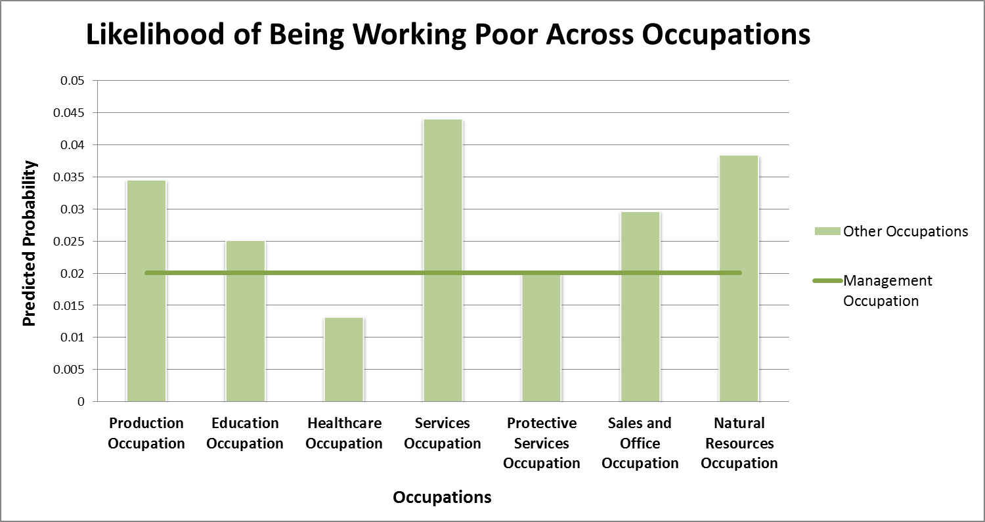
Workers in services occupations are much more likely to be working poor compared with workers in management occupations.
Model results based on data from the American Community Survey, 2011
Notes:
The probability of being working poor for the reference worker in a management occupation is very low, 2%.
The other worker characteristics have the expected effects on the likelihood of being working poor and near poor.
Married (negative) and having a dependent minor child (positive) have the largest effects of all worker characteristics.
Reference worker is male, 42 years old, HS grad, citizen, english proficient, single, no children, not disabled, FTFY worker.
For reference worker in Healthcare, all in sample work in one of three middle skill / middle income jobs: clinical lab technologists, health support technologists, and misc. health technologists.
For reference worker in Management, the range of occupations is much larger including higher skill / higher pay (managers, all other $79k) and relatively lower skill / lower pay occs (food service managers - $36k).
For reference worker in Services, 51% work as either janitors or grounds maintenance workers.

Slide 17
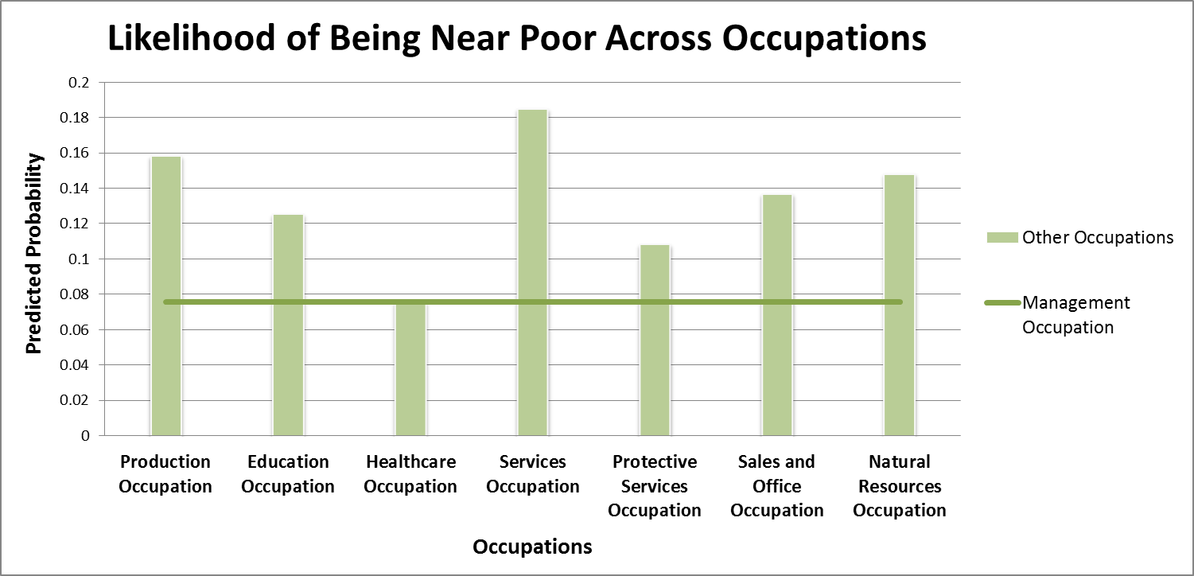
Workers in services occupations are also much more likely to have a near poor level of income compared with workers in management occupations.
Notes:
The probability of having a near poor income for the reference worker in a management occupation is much higher, nearly 8%.
For these workers in services occupations, the probability of having a near poor income is more than 18%.
The effects of occupation are stronger for a worker’s probability of having near poor income than for being working poor.

Slide 18
Where workers live accounts for a small, but significant, share of their overall likelihood of being working poor or near poor.
Notes:
- Region accounts for a larger share of a worker’s overall likelihood of being working poor than having a near poor income.

Slide 19
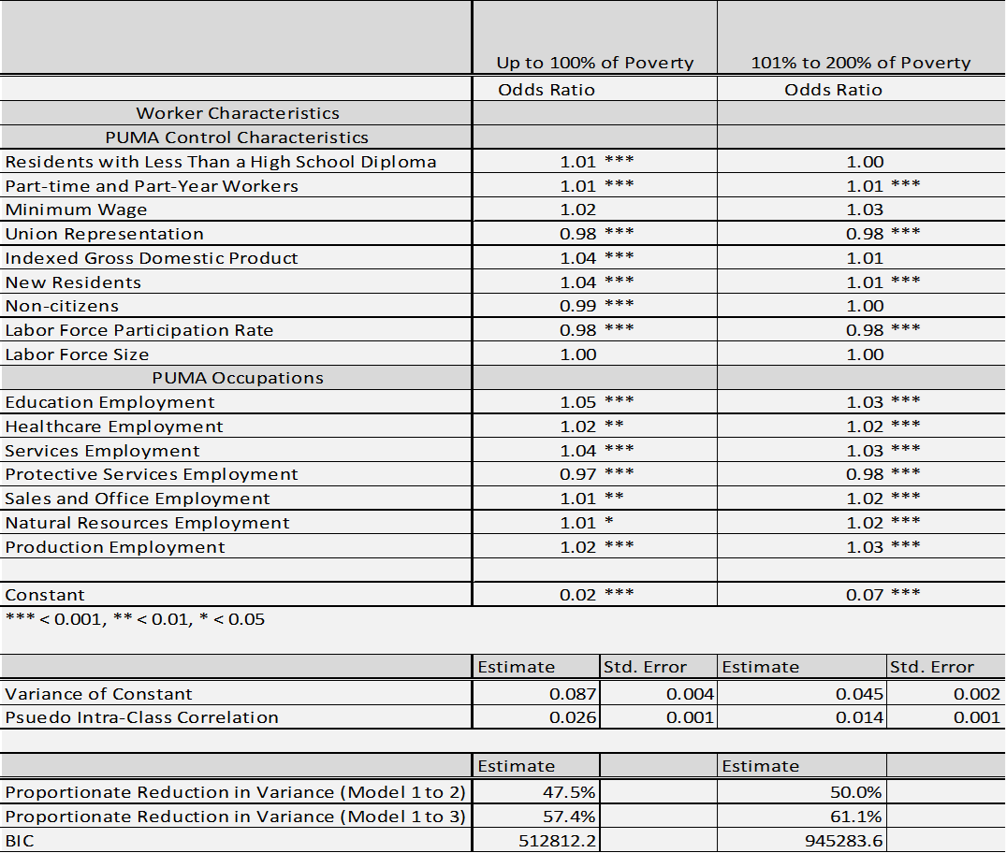
Model Three Results – Regional Occupational Structure
Notes:
- The reduction in BIC from model 1 to model 3 for each dependent variable suggests that adding the regional characteristics, including occupational employment, improve the model fit.

Slide 20
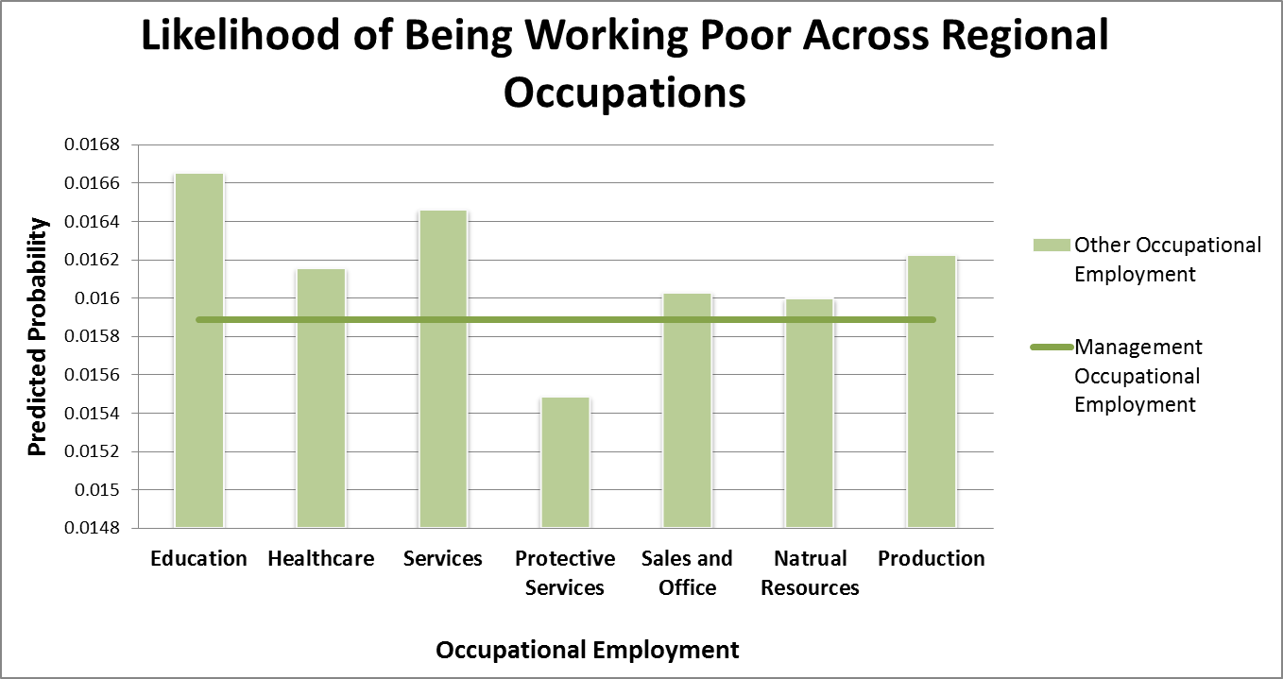
Workers in regions with more people in services or education employment are more likely to be working poor than in regions with more workers in management employment.
Notes:
Occupational employment affects workers’ likelihood of being working poor regardless of which occupation they work in.
Many of the occupational employment variables have the expected effects on the likelihood of being working poor.
Protective services group has a small number of occupations, that are mostly middle skill, unionized, and middle pay work (police officers, firefighters, correctional officers), exception is security guards.
Management group includes a much larger variety of occupations including higher skill / pay (managers, all others - $79k) and relatively lower skill / pay occs (food service managers – $36k).

Slide 21
Workers in regions with more people in services or education employment are more likely to be near poor than in regions with more people in management employment.
Notes:
- The size of the effects of occupational employment are similar for being working poor and having near poor income.

Slide 22
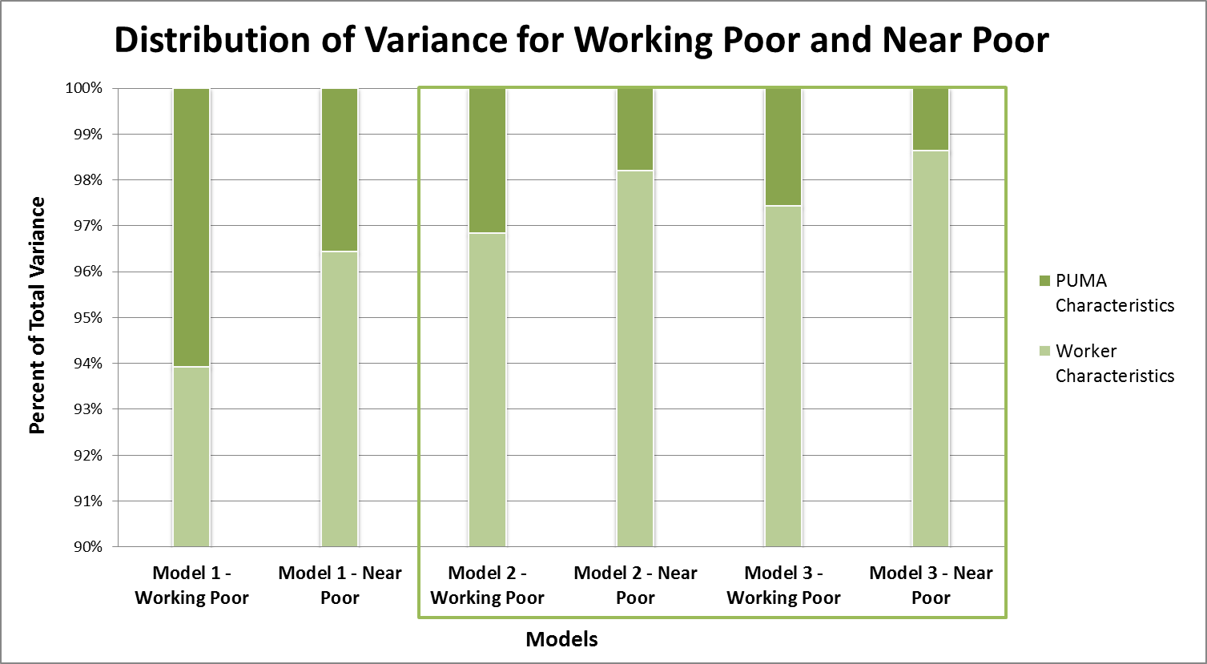
Regional characteristics, including occupational structure, help explain some of a worker’s overall likelihood of being working poor or near poor.
with PUMA control variables
with PUMA and Occupation control variables
Notes:
- For both dependent variables, economic and occupational characteristics reduce the variance at the regional level by more than half.

Slide 23
Conclusions: For the Working Poor and Near Poor
Their occupation matters…
Workers in certain occupations are more likely to be working poor or near poor.
Where they live also matters…
Workers in some regions are more likely to be working poor or near poor.
A small share of a worker’s overall likelihood of being working poor or near poor is dependent on where the worker lives.

Slide 24
For the Working Poor and Near Poor
Because the occupational mix of where they live matters…
Workers in regions with greater employment in certain occupations are more likely to be working poor or near poor.
A region’s occupational mix helps explain a worker’s overall likelihood of being working poor or near poor.

